Slide 1

Web Server and DNS Server

Slide 2



Meet the Team
Ashish Bhandari
Sanjeev Thapa
@savagesanjeev
@_as.hi.sh_

Slide 3

Table of Content
01
Web Server
02
Web Hosting
03
DNS Server
04
What does Web Hosting
Look Like ?

Slide 4
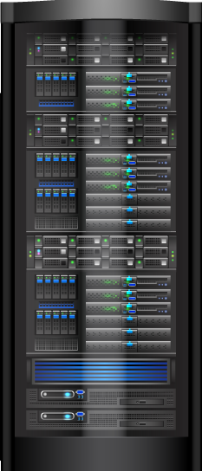



WEB SERVER
Large High Power Computers
Files stored on Web Servers are read by browsers
Typically runs on Linux or Windows
Apache, IIS, Nginx, GWS

Slide 5

WEB
HOSTING

Slide 6
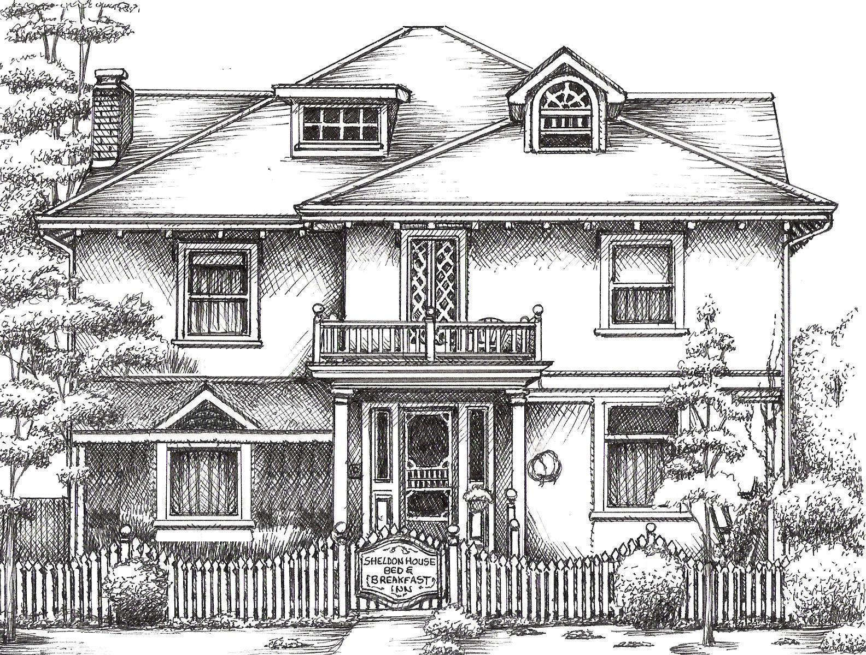
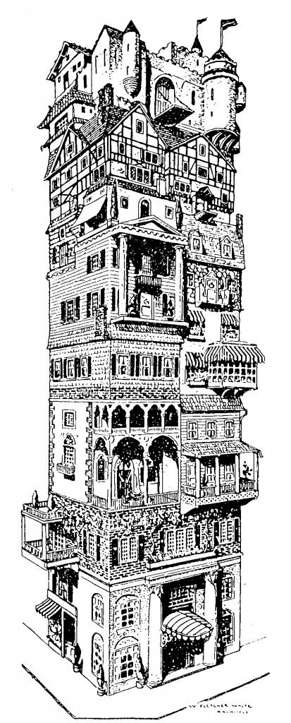

Types of Web Hosting
FREE Hosting
Shared Hosting
Virtual Private Server
Dedicated Servers

Slide 7
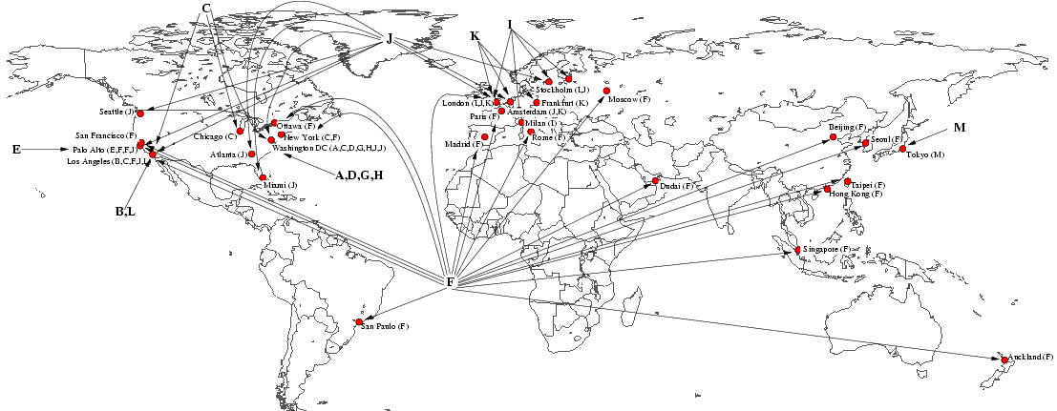

DNS SERVER
Resolves Domain Name to I.P Address
Consists of various Servers and Sets
Hierarchy

Slide 8

TYPES OF DNS SERVER
DNS recursive resolver/DNS resolver
Root name server
Top level Domain/TLD name server
Authoritative name server

Slide 9
How Web Server Works?
Obtains IP Address from domain name
Browsers requests full URL
Web Server responds to request
Browsers display Webpage
Web server
serves
web page
Web browsers
request
web servers

Slide 10


How DNS Server Works?
The user requests
Local DNS is checked
ISP DNS is checked
Receives IP Address and browsers open that address
Root DNS is checked

Slide 11
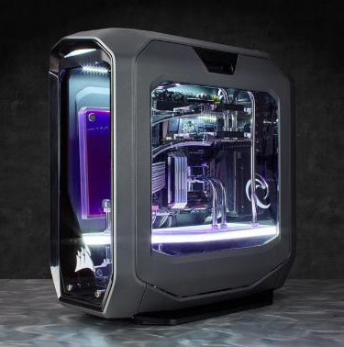

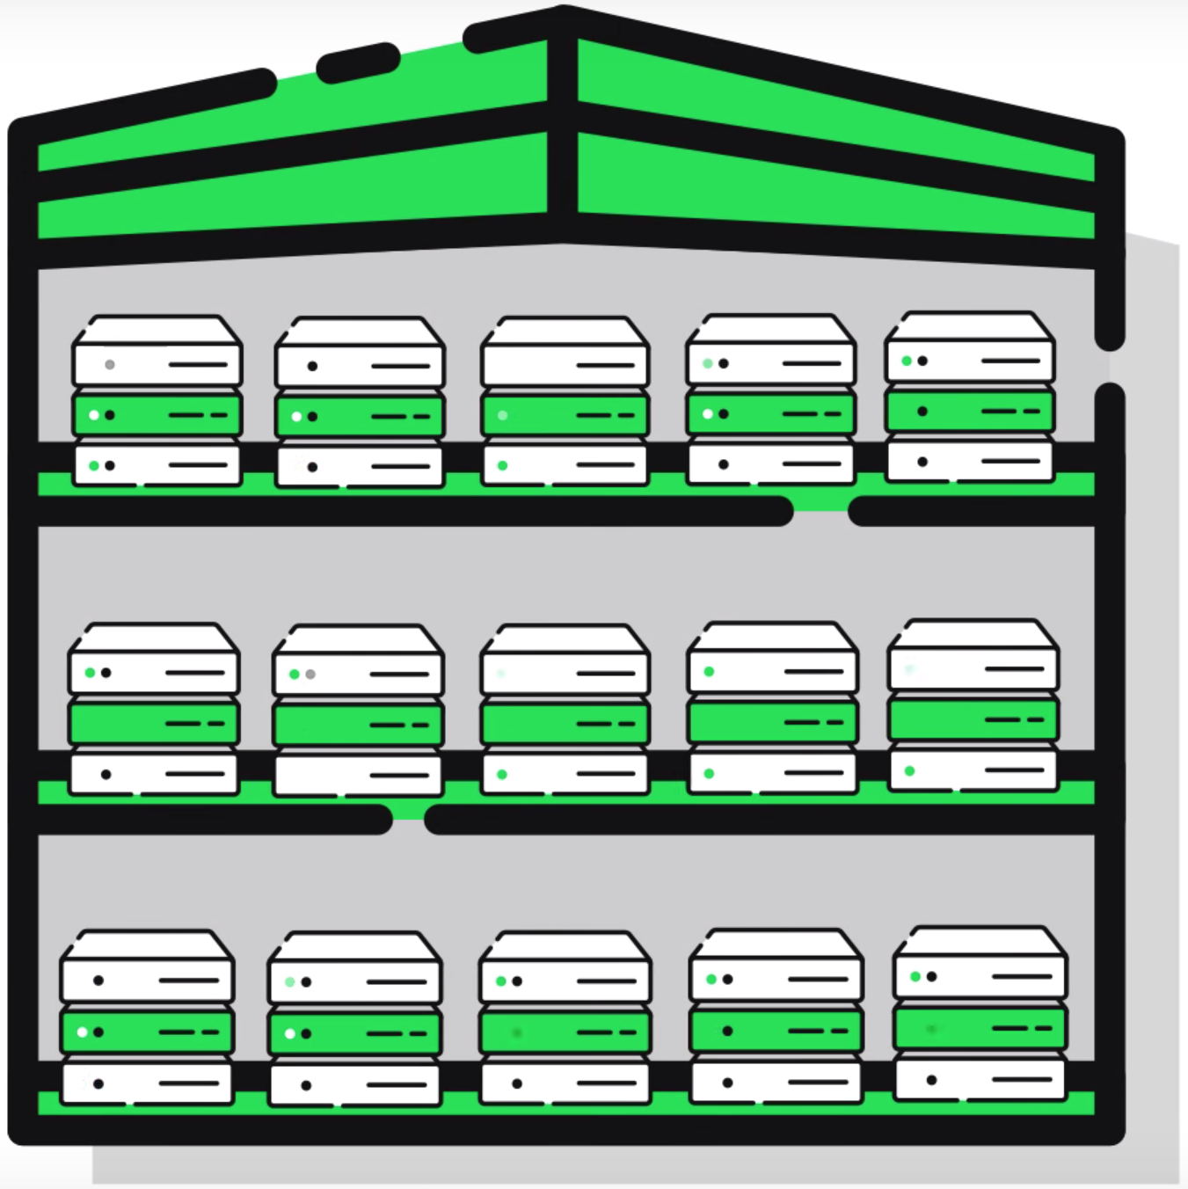





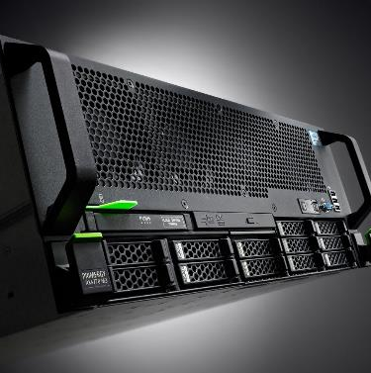
THANK YOU

